Slide 1

Making Tax Digital for VAT
HFMA Webinars
Josh Reardon (NHS SBS - VAT Consultancy)
Claire Williams (HMRC)
11 December 2018 – 1 pm

Slide 2

Your Presenters
  Josh Reardon – Senior VAT Consultant
  NHS Shared Business Services VAT Consultancy
  sbs.taxconsultancy@nhs.net
  Claire Williams – Customer Readiness and External Stakeholder Team
  HM Revenue & Customs

Slide 3

Agenda
  Purpose of the Webinar
What is Making Tax Digital for VAT?
Who is affected and when?
When will it happen? Deadlines.
Functional compatible software
Record keeping requirements
The pilot
VAT 21 submission
NHS specific considerations
Question & Answer

Slide 4
What is Making Tax Digital for VAT?

Slide 5

What is MTD for VAT?
Using MTD compatible software to
        capture business transactions
        prepare the VAT return
        send and receive information
        to and from HMRC via
        API* enabled software
        * Application Programming Interface
5

Slide 6
What is MTD for VAT?
Many things wont’ change
        VAT return frequency
        payment deadlines
        eligibility for schemes
MTD for VAT is not changing what you do
- but how you do it.
6

Slide 7
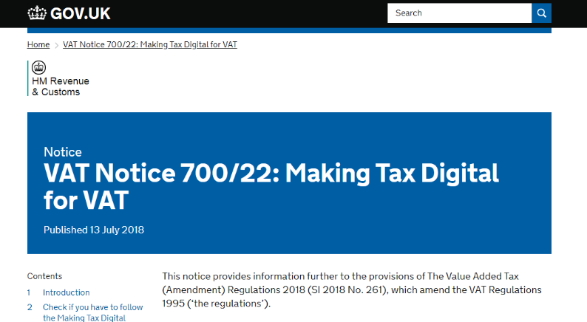
Find out more in VAT Notice 700/22

Slide 8
Who is affected and when?

Slide 9
Who is affected – and when?
Section 2
Notice 700/22

Slide 10
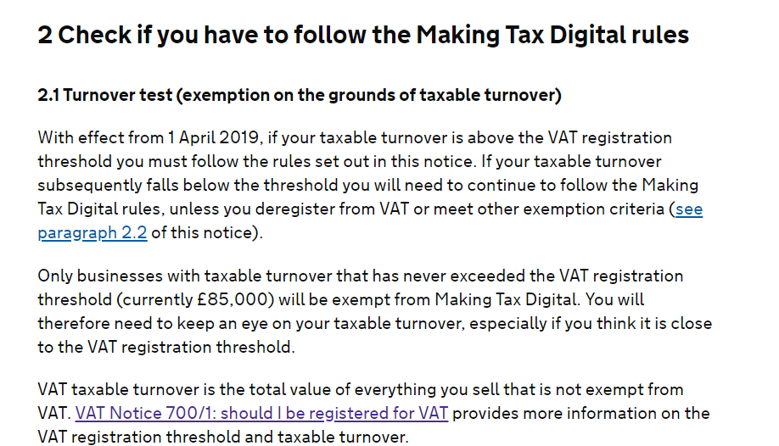
Who is affected – and when?
Section 2
Notice 700/22

Slide 11
Who is affected – and when?
From April 2019 –
VAT Registered entities with a taxable turnover above the VAT threshold must follow the MTD rules
VAT threshold currently £85,000
From the first VAT period that starts on or after 1 April 2019.
Deferred categories -
www.gov.uk/government/publications/making-tax-digital/overview-of-making-tax-digital
Notice 700/22
Section 2

Slide 12
Functional compatible software

Slide 13

‘Functional Compatible Software’
Section 3.2
Notice 700/22
A software program, or set of programs used to
keep digital records
send information and returns from data held in the digital records
receive information from HMRC via the API platform

Slide 14
Common queries
Does that include spreadsheets?
What is bridging software?
API enabled
Bridging software
Digital links between software
What is a digital link?

Slide 15
Common queries
Does that include spreadsheets?
What is bridging software?
API enabled
Bridging software
Digital links between software
What is a digital link?
Digital tool to connect accounting software to HMRC systems See 3.2 .3

Slide 16
Common queries
Does that include spreadsheets?
What is bridging software?
API enabled
Bridging software
Digital links between software
What is a digital link?
Digital tool to connect accounting software to HMRC systems See 3.2 .3
An electronic or digital transfer of data between software programs, products or applications.

Slide 17
Digital links
An electronic or digital transfer of data between software programs, products or applications.
Para 3.2.1
Notice 700/22
No manual intervention or
re-typing information from one product to another.
No copying and pasting
Does include XML import or export, and macros or linked cells in spreadsheets

Slide 18
Common queries
An extra year for businesses to arrange for digital links between all parts of their software.
3.2.1.1
What is the soft landing period
Only applies to mandatory digital links. Must have digital record keeping and API product in place from the start.

Slide 19
Record keeping requirements

Slide 20
Records that must be kept digitally
Section 3.3
Notice 700/22

Slide 21
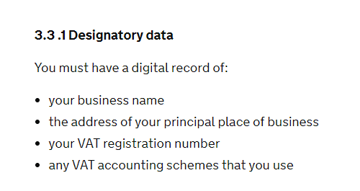
Records that must be kept digitally
Section 3.3
Notice 700/22

Slide 22
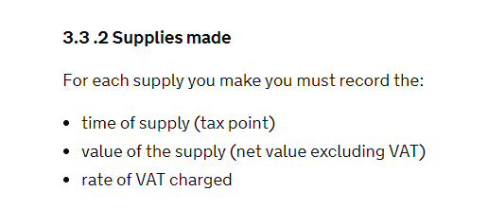
Records that must be kept digitally
Section 3.3
Notice 700/22

Slide 23
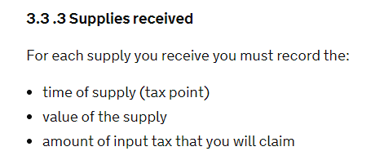
Records that must be kept digitally
Section 3.3
Notice 700/22

Slide 24
Making Adjustments
Section 3.4
Notice 700/22
Record the total for each type of adjustment
Calculation does not have to be done in the MTD software
Result of calculation can be entered manually into the MTD software.

Slide 25
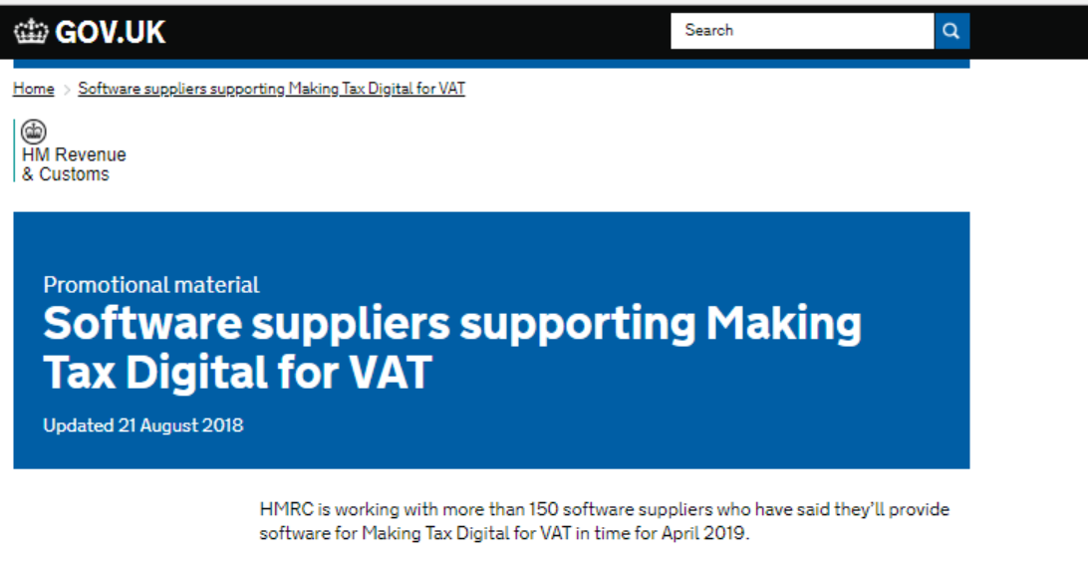
Using software

Slide 26
The Pilot

Slide 27
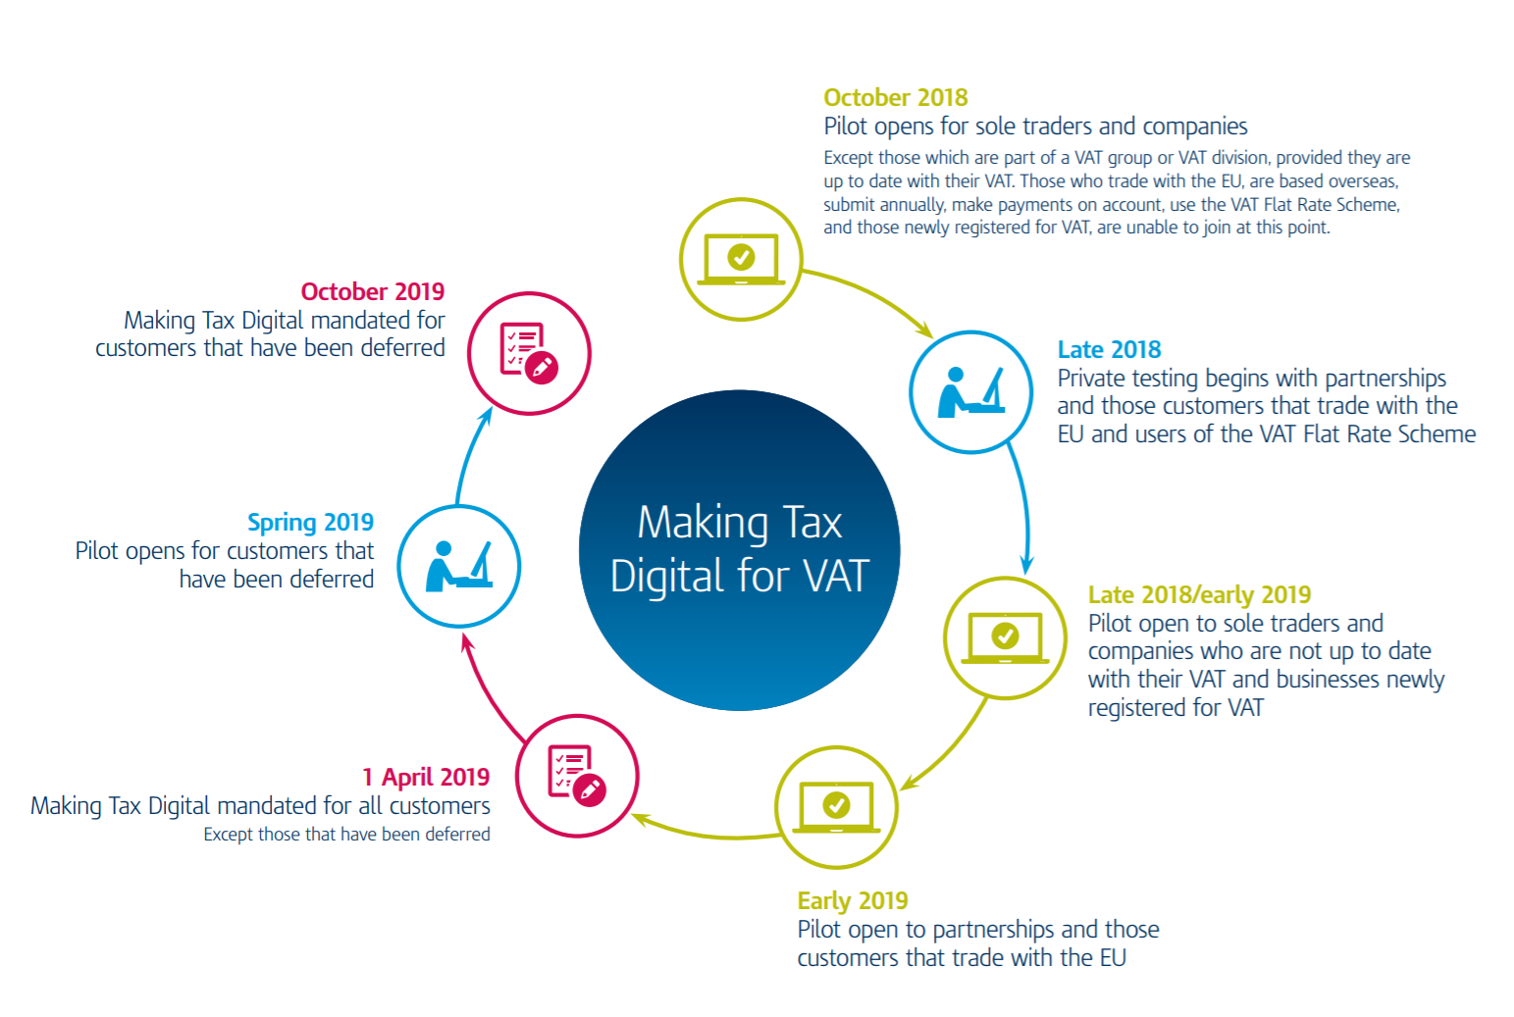

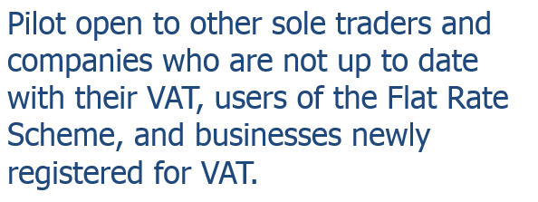
MTD Timeline

Slide 28
VAT 21 submission

Slide 29
The legislation does not currently mandate the submission of the VAT 21 via functional compatible software. However, HMRC are currently undertaking a piece of work to assess the impact of this requirement which may lead to the VAT 21 being mandated as part of Making Tax Digital for VAT legislation.
As we understand, the software currently available does not allow for the submission of a VAT 21 as it is not yet mandated. Should the submission of the VAT 21 be included in the Making Tax Digital legislation, NHS bodies should ensure they have software capable of submitting a VAT 100 and VAT 21.
NHS Shared Business Services are working with a HMRC recognised software developer to develop a cloud based interface capable of submitting VAT 100 and VAT 21 data. This will be payable via a license fee and made available to all NHS organisations.

Slide 30
NHS specific considerations

Slide 31
Does the six-month deferral apply to all NHS organisations? The deferral will only apply to NHS organisations that are required to submit additional information with their VAT returns e.g. VAT 21. Community interest companies and other NHS organisations that don’t fall within s41 of the Value Added Tax Act 1994 are unlikely to be deferred and should prepare for 1 April 2019 implementation. HMRC have confirmed that they will write to all deferred organisations and those organisations who do not receive a letter should prepare for a 1 April 2019 implementation.
What about wholly owned subsidiaries? HMRC have confirmed that wholly owned subsidiaries should not anticipate the deferral to apply to them. Only if a wholly owned subsidiary receives a deferral letter does the deferral apply, but this is unlikely.
Is the deferral optional? Deferred customers will be able to join the pilot in the Spring. HMRC plan to have the functionality in place for organisations to voluntarily sign up and submit their VAT return through the service before they are mandated to do so.

Slide 32
NHS record keeping requirements
  NHS Shared Business Services – Finance & Accounting Clients
  For organisations who use NHS Shared Business Services for the preparation of VAT returns, please be aware that we have engaged directly with HMRC in respect of your digital record keeping. Following a teleconference with HMRC it was confirmed:
  "NHS SBS had submitted a narrative and illustrations of its VAT data journey to HMRC, and was seeking advice as to whether this current process would be MTD compliant from April 2019. On review, HMRC was confident that the journey as laid out would be MTD compliant."

Slide 33
NHS record keeping requirements
  All other organisations
  All other organisations should review their digital links in combination with the Making Tax Digital for VAT legislation to ensure compliance. Whilst HMRC has allowed a soft-landing period in respect of digital recording keeping until 1 April 2020, NHS organisations should ensure a review is undertaken as soon as possible so any process changes can be made in good time.

Slide 34
Q&A

Slide 35
Thank you for listening!

